Slide 1
Vue.js & Rails: An Unlikely Friendship
KC Ruby, March 2019

Slide 2

What is Vue.js?
Notes:
This video is the same as the "Why Vue.js?" video from vuejs.org.

Slide 3



The Power of Vue: Components
Components are chunks of HTML, JavaScript, and CSS.
Single-file components group related HTML, JS, and CSS together.
Notes:
In contrast to Angular, which expects the HTML template, TypeScript, and CSS to be in different files, Vue has single-file components that include the HTML template, JavaScript, and CSS all in one file. This keeps the directory structure simple and makes it easy to import and export components since you only have one file to deal with.

Slide 4
Anatomy of a Component
<template>
<div class="my-component"></div>
</template>
<script>
export default {
name: 'MyComponent'
};
</script>
<style scoped>
</style>
Notes:
A component is made up of an HTML template (HTML or Pug), a JavaScript object (JavaScript or TypeScript), and scoped CSS (CSS, LESS, SASS, Stylus, etc.).
Note that a component's <template> can only have one root element inside of it. This is because the <template> tag doesn't actually get rendered – it only renders what's inside of it – so the component needs a container to live inside of. This is usually a <div> with a class of the component name, but it doesn't have to be.
The CSS can be scoped in many ways. The most common is to use the "scoped" attribute on the style tag, which will add a unique data attribute so that those styles are only associated with that component. Styles that are scoped in this way do NOT apply to children (components within the component), they only apply to the current component. Scoping can alternatively be achieved through CSS modules or a class-based strategy. See https://vuejs.org/v2/style-guide/#Component-style-scoping-essential for more details.
There are some cases where an HTML template just can't cut it and you need the full power of JavaScript to render your HTML. For those cases, Vue also supports JavaScript render functions as well as JSX (like React).

Slide 5
Anatomy of a Component (Continued)
Property | Purpose
components: { } | Register components used in template
props: { } | Properties passed in by parent component
data ( ) | Initialize properties that can be manipulated
computed: { } | Functions that always return a value
methods: { } | Other functions
beforeMount ( ) | Function to be executed before the component loads
mixins: [ ] | Include shared code as part of the component
Notes:
You have to register custom components before they can be used - Vue doesn't know what to do with <my-component> unless you tell it which component that tag references. You can register a component globally with Vue.component() or in one component via the components: {} property. (If you forget to register a component, Vue will throw a warning/error like "Did you forget to register this component?" The answer is always yes.)
beforeMount() is just one example of a lifecycle hook that can be used. Other common examples are beforeCreate(), created(), mounted(), and destroyed(). See https://vuejs.org/v2/api/#Options-Lifecycle-Hooks for more details.
There are many more properties/options you can add to components, but these are the most common. There's even a recommended order to how you should arrange the properties: https://vuejs.org/v2/style-guide/#Component-instance-options-order-recommended (but of course it's JavaScript, so nothing is truly enforced).

Slide 6
<template>
<div :class="myClass">
<custom-component>{{ formatText('Hello World') }}</custom-component>
</div>
</template>
<script>
import CustomComponent from '@/components/custom-component'
export default {
components: {
CustomComponent
},
props: {
myClass: {
type: String,
default: 'my-component'
}
},
methods: {
formatText(text) { return text + '!!!' }
}
};
</script>
Notes:
This is an example of a single-file component that has one "child", CustomComponent. Note that CustomComponent has to be imported and registered in order for it to be used. <div :class="myClass"> means that the class attribute of the div is bound to "myClass", which in this case is a prop (it could also be a data or computed property), meaning it's being passed in from some other component that's using this component (its "parent").
Here, we're using a method, formatText(), to add '!!!' to the end of whatever text we pass in, in this case 'Hello World'. We could have also done this with a custom filter (similar to Angular's filters), but methods are generally easier to understand for those not familiar with other JavaScript frameworks. For more details on filters: https://vuejs.org/v2/guide/filters.html

Slide 7
Common Directives in Templates
Directive | Purpose
v-bind (:) | Binds attributes to data or expressions
v-for | Renders the specified element for each item in an array
v-if | Only renders the specified element if condition is true
v-else | Can be used with v-if
v-model | Creates a two-way binding to a data property
v-on (@) | Creates an event listener
Notes:
These aren't the only directives, but they're the most common. They should feel somewhat familiar to Angular's directives because they were inspired by Angular. Vue's documentation provides excellent examples of all of these (though not all in one place).
You can also create your own custom directives: https://vuejs.org/v2/guide/custom-directive.html

Slide 8
<template>
<div :class="myClass">
<custom-component>{{ formatText('Hello World') }}</custom-component>
</div>
</template>
<script>
import CustomComponent from '@/components/custom-component'
export default {
components: {
CustomComponent
},
props: {
myClass: {
type: String,
default: 'my-component'
}
},
methods: {
formatText(text) { return text + '!!!' }
}
};
</script>
Notes:
Note that ":class" is short for "v-bind:class". We're using the v-bind directive to bind the "class" attribute of the <div> to the "myClass" variable. If you want to set an element's attribute to anything other than a static string, you'll need to use v-bind! <div class="myClass"> will render a div with a literal class of "myClass". <div :class="myClass"> will render a div with a class of whatever the myClass variable evaluates to.

Slide 9
The Flow of Information
Parent Component
<child-component
:data-from-parent="dataToSendToChild" @event="actOnDataFromChild" />
Props
Events
Child Component
props: {
dataFromParent: {
type: String
}
}
methods: {
sendDataToParent(value) {
this.$emit('event', value);
}
}
Notes:
Components are isolated by default – each one lives in its own little world that has no knowledge of any other components. When you need nested components to be able to talk to each other, you can pass props to children and emit events to parents.
In this case, our ParentComponent (parent-component.vue) references a <child-component>. It passes in a data-from-parent attribute to the ChildComponent and binds it to a dataToSendToChild variable (could be a prop, data, or computed property). The ChildComponent accepts the dataFromParent as a prop, and enforces that it should only ever be a String. If ParentComponent tries to pass something other than a String to the dataFromParent attribute, Vue will throw an error.
In order for the ChildComponent to send some of its data back to the parent, it has to emit an event. $emit() takes two arguments: the event name and the data you want to pass. In this case, our event is literally named "event", but it should normally be a more relevant name, like 'data-filtered' or 'search-entered'. In the ParentComponent, we're using @ (v-on directive) to execute actOnDataFromChild() when the event named "event" is emitted. It's similar to putting @click (v-on:click) on a button and expecting our method to execute when the button is clicked, except it's our own custom event that's getting triggered when something happens in the ChildComponent. Events do NOT "bubble up" - only the direct parent will receive the event.
For more information on props and events:
https://vuejs.org/v2/guide/components.html#Passing-Data-to-Child-Components-with-Props
https://vuejs.org/v2/guide/components.html#Listening-to-Child-Components-Events

Slide 10
Vue Ecosystem & Common Add-ons
Library | Purpose
vue-router | Routing for single-page applications
vuex | Centralized state management
axios | HTTP requests
vue-i18n | Multi-language support
eslint | Enforces syntax rules for JavaScript
webpack | Builds and compiles assets
Notes:
Like React, the base Vue library is intentionally lightweight. By itself, it's small enough to be a simple replacement for jQuery that's basically only needed for DOM manipulation. But by adding in additional libraries, Vue can become a full-featured framework capable of producing Single-Page Applications, Progressive Web Apps, and even native mobile apps, with or without a server-side back-end.
List of preferred Vue libraries: https://curated.vuejs.org/

Slide 11


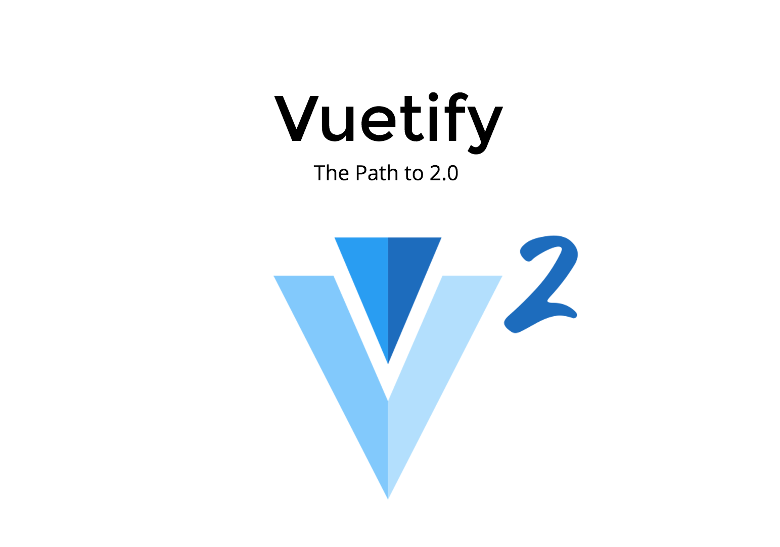


UI Frameworks for Vue
Notes:
UI Frameworks not only provide pre-built components, making it super easy to get a good-looking application up and running quickly, but they can also add a lot of useful default functionality as well.
Quasar, for example, includes wrappers for Cordova and Electron, making it possible to develop native mobile apps from the start. It also includes a lot of those libraries from the previous slide by default (with the option to pick and choose options during project initialization) and abstracts away most of the confusing Webpack configuration. The next version (1.0.0) will supposedly even include unit testing out of the box.

Slide 12


Pairing Vue.js with Ruby on Rails
Notes:
We'll discuss two options/patterns for integrating Vue with Rails. These probably aren't the only two options available, but they're definitely the most common.

Slide 13
Option 1: Use Vue with Rails Views
Starting in Rails 5.1, you can create a new Rails app with Webpack and Vue through the Rails CLI.
In this pattern, each Rails view is essentially its own tiny Vue app.
The Vue app (component) is initialized in the .js file for the view.
The .html.erb file becomes the template for the Vue component and can utilize both Vue template syntax and Ruby template syntax.
Notes:
When you create a new rails app with the --webpack=vue option, it actually includes instructions (in app/javascript/hello_vue.js) on how to use Vue this way. Note that using this pattern, you will NOT be using single-file Vue components. The benefit, though, is that you can mix Ruby and Vue as needed.
This approach is most useful if you're already using a full Rails app and have already built out some or all of your views, but are tired of jQuery's messy code and event handlers.

Slide 14
Option 2: Rails API with Vue App
Rails API
Vue App
Notes:
This option involves having a separate Vue app that talks to your Rails app via REST API calls. They can be in separate repositories or within the same repository, but this pattern involves a more full-featured Vue app that has its own routing (vue-router) and modules (vuex store). axios can be used to get and post data to and from Rails endpoints from the Vue app.
This approach is particularly useful when you have a front-end developer and back-end developer working simultaneously. The Vue app can be set up with a mock server (using express, json-server, or some other library) that allows the front-end developer to mock the response they expect to receive from the API and build the UI accordingly. Meanwhile, the back-end developer can add the endpoint and do the work necessary to ensure that it returns the correct response.

Slide 15
Questions?

